Slide 1
1. Question
Digital Privacy & Security
Next
1
2
3
4
5
Suppose that you and a friend are both shopping online for a new pair of boots. When you conduct your online searches, you get different results than your friend. Why is that? How do stores and search engines know so much about you?
View the video on the right to learn how companies use information from your digital trail. In this Slam Dunk, you’ll learn how to ensure the privacy and security of your personal information when you’re online.
Source: Common Sense Media
How can I guard against identity theft and protect my personal and private information in the digital world?

Slide 2
2. Information Sources
Next
1
2
3
4
5
Gather some information from these sources that will help you to answer the Essential Question posed on Slide 1. Make some notes, summarizing main ideas and important details from the sources you explore.
Refer to these key Vocabulary terms and definitions as you do your research.
The secrets of Cyber Hacking (video)
What is Phishing?
Phishing Explanation (video)
“Social Networks Are Vulnerable to Crime”
Kids & Identity Theft (audio)
Click a link and RAT software secretly installed
Teen’s Credit Ruined by Identity Theft (YouTube video)
Kids & Identity Theft-How It’s Done (YouTube video)
Cell phone Spyware (YouTube video)
Detecting Spyware on your phone (YouTube video)
Stores Use Phones to Track Customers
Sample Phishing Emails

Slide 3
3. Student Activity
Next
1
2
3
4
5
Now that you have researched how companies and individuals can access and use your data, you need to know how to monitor and control this activity. Many Websites have Privacy Policies or Terms of Use, but these are often overlooked by users.
Select a Website of your choice (Amazon, Google, Hulu, Facebook, Wikipedia, etc.) and read their Privacy Policy or Terms of Use; this information is usually linked at the bottom of the homepage. *Remember that some Websites that you typically visit may not be accessible inside the school network; blocked sites may be analyzed from home.
Complete this Privacy Policy analysis activity for your chosen Website. Then, respond to these questions about your analysis in a face-to-face or online class discussion:
Do you mind that the site collects information about you? Why or why not?
Does it make a difference what kind of information a site collects about you?
What do you get in return for the information? Is the exchange worth it to you?
Protecting your Facebook Privacy
Click this link to see the video

Slide 4
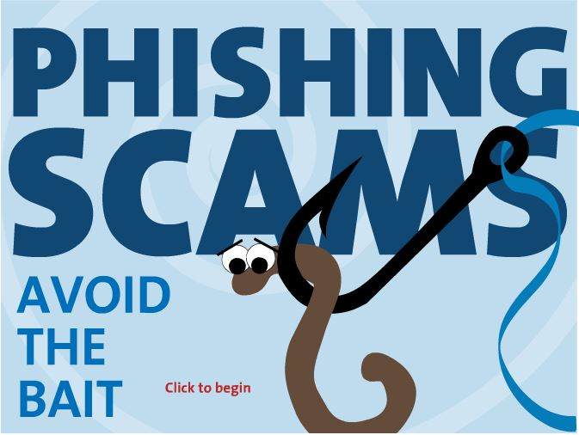
4. Assessment Activity
Next
1
2
3
4
5
Take this quick online quiz to check your understanding of digital privacy and security.
Then, test your ability to avoid phishing scams by playing the interactive game linked on the right.
Optional: Design a simple creative product which explains to other teens how they can guard against identity theft and protect their personal and private information in the digital world.
Use a digital or non-digital creative tool of your choice.
Include key vocabulary terms/definitions, main ideas, and details from your notes.
Share your product with your school community or a wider audience.
Click the image to launch the Phishing Scams Interactive Game.
Image Source: OnGuardOnline.gov, Federal Trade Commission
Notes:
https://testmoz.com/335396/admin
http://testmoz.com/335396

Slide 5
5. Teacher Support Materials
1
2
3
4
5
Digital Citizenship: High School
Maryland Technology Literacy Standards
Standard 2.0 Digital Citizenship: Demonstrate an understanding of the history of technology and its impact on society, and practice ethical, legal, and responsible use of technology to assure safety.
Common Core State Standards Reading: 1. Read closely to determine what the text says explicitly and to make logical inferences from it; cite specific textual evidence when writing or speaking to support conclusions drawn from the text. Writing: 7. Conduct short as well as more sustained research projects based on focused questions, demonstrating understanding of the subject under investigation.
Standards for the 21st Century Learner 1.1.6 Read, view, and listen for information presented in any format (e.g. textual, visual, media, digital) in order to make inferences and gather meaning. 2.1.3 Use strategies to draw conclusions from information and apply knowledge to curricular areas, real-world situations, and further investigations. 3.1.4 Use technology and other information tools to organize and display knowledge and understanding in ways that others can view, use, and assess.
3.1.6 Use information and technology ethically and responsibly.
ISTE Standards for Students
1. Creativity and innovation: Students demonstrate creative thinking, construct knowledge, and develop innovative products and processes using technology. a. Apply existing knowledge to generate new Ideas, products, or processes. b. Create original works as a means of personal or group expression 3. Research and Information Fluency: Students apply digital tools to gather, evaluate, and use information. b. Locate, organize, analyze, evaluate, synthesize, and ethically use information from a variety of sources and media. 4. Critical Thinking, Problem Solving, and Decision Making: Students use critical thinking skills to plan and conduct research, manage projects, solve problems, and make informed decisions using appropriate digital tools and resources. c. Collect and analyze data to identify solutions and/or make informed decisions. 5. Digital Citizenship: Students understand human, cultural, and societal issues related to technology and practice legal and ethical behavior. 5a. Advocate and practice safe, legal, and responsible use of information and technology.
Time Frame: 1-2 class periods
Differentiation strategies for this lesson:
Direct students to use learning tools included in our GCPS-licensed databases, such as: audio read-aloud, labeled reading levels/Lexiles, and embedded dictionaries.
Multiple media formats enable all learners to be engaged.
Students can complete independently or with a partner or small group.
Notes to the teacher:
Collaborate with your school library media specialist to implement this lesson.
Headphones/speakers needed for video resources in this lesson.
For supplementary materials and answer keys, see the Common Sense Media Lesson Plan: What’s the Big Deal About Internet Privacy? (Grades 9-12/Unit 3), from which materials in this Slam Dunk have been used or adapted.
Last updated April 2015
Modified, reproduced, and published with permission from GCPS-ODL. The models can be used for non-profit, educational school use only.

