Slide 1
1. Question
Positive Posting & Public Online Presence
Next
1
2
3
4
5
6
What you do online can follow you forever, even beyond your lifetime! Future employers, college admissions officers, neighbors and even your future children may be able to see everything you have EVER posted online. You need to take steps to protect your reputation and make sure that your online persona is a positive one!
Click the image above to play Brittany’s story in a new window.
Image Source: Common Sense Media
How could what I post and share online affect my reputation and public online presence?

Slide 2
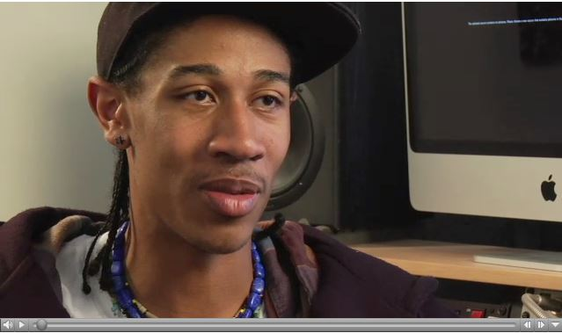
2. Information Sources
Next
1
2
3
4
5
6
Review the following resources about your online reputation.
“They Loved Your GPA Then They Saw Your Tweets”
“California Tries to Save Kids From Themselves”
College Admissions Officers Check Digital Trails
The Right to be Forgotten
When Someone Has the Same Name as You
Online Reputation Management
Online reputations can benefit you as much as harm you. Click the image above to open Abbas’s story in a new window.
Image Source: Common Sense Media

Slide 3
3. Student Activity
Next
1
2
3
4
5
6
After reviewing the sources on slide 2, examine the two applicants who are vying for the last remaining spot in a college’s freshmen class. In terms of grades, test scores and essays, the applicants are equal.
Markus
Tommy
As you review the applicants, use this organizer. Finally, justify your selection of applicant.
Image Source: Clipart.com, by subscription.

Slide 4
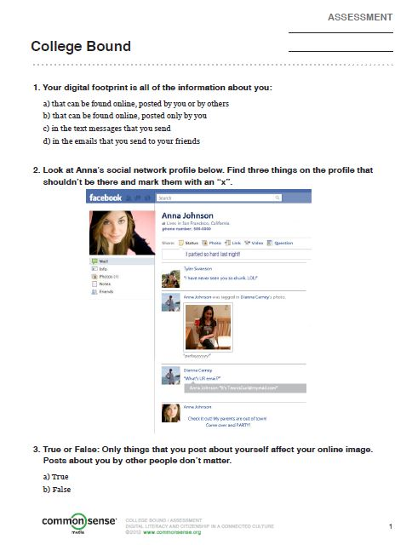
4. Assessment Activity
Next
1
2
3
4
5
6
Using all of what you have learned, examine the profile on the right (click on the image to open it as a Word document). Draw an X over the portions of the profile that may concern a potential college admissions officer or employer. Then write a sentence by each item to explain why it is problematic.
Image Source: Common Sense Media

Slide 5
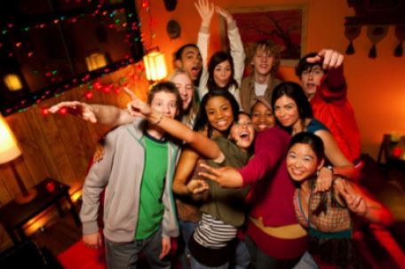
5. Enrichment Activities
Next
1
2
3
4
5
6
You should also consider the online reputations of your friends when you post online.
Will my post harm or embarrass my friend?
Have I asked my friend if it is ok to post?
Brainstorm with your partner(s) and create a list of photo captions that would be problematic for online posting of the image to the left.
Should a friend ever post anything about you that bothers you, you can ask to have it removed and untag yourself from images (link will be blocked in school) .
Image Source: Common Sense Media

Slide 6
6. Teacher Support Materials
1
2
3
4
5
6
Digital Citizenship: Middle School or High School
Maryland Technology Literacy Standards
Standard 2.0 Digital Citizenship: Demonstrate an understanding of the history of technology and its impact on society, and practice ethical, legal, and responsible use of technology to assure safety.
Common Core State Standards Reading: 1. Read closely to determine what the text says explicitly and to make logical inferences from it; cite specific textual evidence when writing or speaking to support conclusions drawn from the text. Writing: 7. Conduct short as well as more sustained research projects based on focused questions, demonstrating understanding of the subject under investigation.
Standards for the 21st Century Learner 1.1.6 Read, view, and listen for information presented in any format (e.g. textual, visual, media, digital) in order to make inferences and gather meaning. 2.1.3 Use strategies to draw conclusions from information and apply knowledge to curricular areas, real-world situations, and further investigations. 3.1.4 Use technology and other information tools to organize and display knowledge and understanding in ways that others can view, use, and assess.
3.1.6 Use information and technology ethically and responsibly.
ISTE Standards for Students
1. Creativity and innovation: Students demonstrate creative thinking, construct knowledge, and develop innovative products and processes using technology. a. Apply existing knowledge to generate new Ideas, products, or processes. b. Create original works as a means of personal or group expression 3. Research and Information Fluency: Students apply digital tools to gather, evaluate, and use information. b. Locate, organize, analyze, evaluate, synthesize, and ethically use information from a variety of sources and media. 4. Critical Thinking, Problem Solving, and Decision Making: Students use critical thinking skills to plan and conduct research, manage projects, solve problems, and make informed decisions using appropriate digital tools and resources. c. Collect and analyze data to identify solutions and/or make informed decisions. 5. Digital Citizenship: Students understand human, cultural, and societal issues related to technology and practice legal and ethical behavior. 5a. Advocate and practice safe, legal, and responsible use of information and technology.
Time Frame: One 90-minute class period
Differentiation strategies for this lesson:
Direct students to use learning tools included in our GCPS-licensed databases, such as: audio read-aloud, labeled reading levels/Lexiles, and embedded dictionaries.
Use of mixed media allows learners of all types to be engaged.
Students can complete independently or with a partner.
Notes to the teacher:
Collaborate with your school library media specialist to implement this lesson.
Answer keys available online at CommonSenseMedia
Students may complete this lesson independently in school or at home.
Headphones/speakers necessary for the video components of this lesson.
Last updated April 2015
Modified, reproduced, and published with permission from GCPS-ODL. The models can be used for non-profit, educational school use only.

